Slide 1
Team Lead 3 Presentation
Chadwick, Toby, Bob

Slide 2
Presentation Outline
Introduction
What is testing
Why is testing important
Types of testing
Unit and Stress Testing
Writing testable code (loose coupling)
Edit mode Vs. Play mode tests
Setting up testing (assemblies)
Boundary tests
Creating boundary tests
Executing tests
Stress testing
Patterns
What is a pattern
Creational, Structural, and Behavioral Patterns
Chadwick
2/45

Slide 3
Individual Requirements (by next Tuesday)
Initial Test Plan
Fully Automated:
Unit tests of at least two different boundary tests for a single script
Can be automated or manual:
A single stress test that breaks unity and records the breaking point as well as logs it in the console
The stress test visually shows the stress on Unity
The failure under stress can be implied (logs success until failure)
Chadwick
3/45

Slide 4
What is Testing?
Testing is intended to show that a program does what it is meant to and to catch defects before release.
Testing is executing a program with artificial data
A part of a software validation and verification process
Testing can reveal the presence of errors but not their absence.
Results can be checked for information on errors, and non-functional aspects of the program
Chadwick
4/45

Slide 5
Why is testing Important?
Allows us to find situations in which software operates incorrectly
Enables us to validate that the software meets its requirements
Validation
Shows that the system is operating as intended from design and implementation
Operates correctly under a set of test conditions
Chadwick
5/45

Slide 6

Types of Testing
There are several different types of software testing:
System testing
Use-case testing
Release testing
User testing
Alpha
Beta
Acceptance
Requirement based testing
Performance testing
Stress testing
Chadwick
6/45

Slide 7
System Testing
System testing is the testing of a fully integrated and complete piece of software.
Use -case testing is a basis for system testing.
Use cases are used to identify the interactions of the system
These interactions between system components are then tested
Chadwick
7/45

Slide 8
Release Testing
Release testing is a form of system testing.
There are some key differences between the two:
A separate team not involved in development is responsible for release testing
System testing should be focused on discovering bugs
Release testing should check whether a system meets its requirements and is ready for validation testing
Chadwick
8/45

Slide 9
User Testing
User testing is a type of testing in which the customers/users provide input on system testing.
It is essential to conduct even after release and system testing because the user’s environment can’t be reproduced in a testing environment.
Alpha
Users work with the dev team to test the software at the developer’s site
Beta
A release of the software is made available to users to allow them to experiment and find problems with the system
Acceptance
Customers test a system to decide whether or not it is ready to be accepted from the developers
Chadwick
9/45

Slide 10
Requirement Based Testing
Involves examining each requirement of a system and designing a specific test (or tests) for that requirement
Chadwick
10/45

Slide 11
Performance Testing
Performance tests typically involve tests that incrementally increases the load on a system until the performance of that system reaches an unacceptable point
Stress Testing
Stress testing is a form of performance testing where the system is purposefully overloaded to see how it would react in a failure scenario
Seeks to test and analyze the failure behavior of the system
Chadwick
11/45

Slide 12
Create Loosely Coupled Code
Code is easier to understand
Makes program more modular
Program is easier to change, update, and expand
More testable code
Toby
12/45

Slide 13
One Function, One Function
One function should have only one function
Functions should be non-deterministic
Single Responsibility Principle
A function should either produce or process information, not both.
If a function needs extra data, have it passed as a parameter
Inversion of Control
Separate decision making code and action code
Toby
13/45

Slide 14
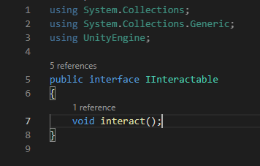
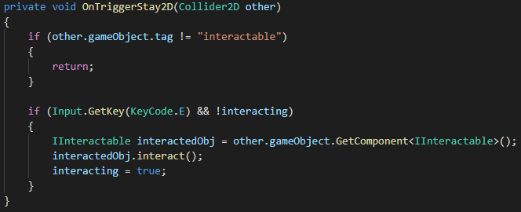
Interfaces
Very helpful in keeping code loosely coupled
Toby
14/45

Slide 15
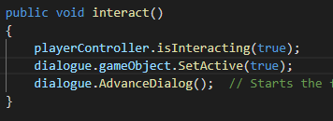
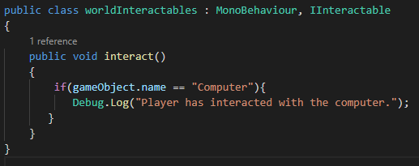
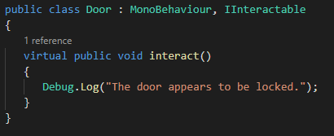
Interfaces
A single function call can have many implementations
Toby
15/45

Slide 16
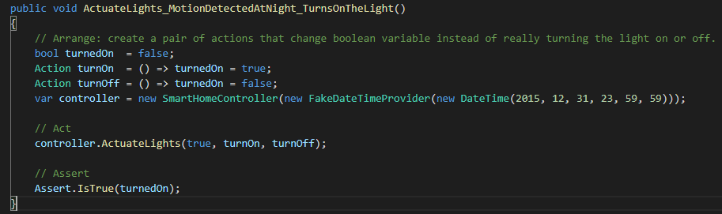
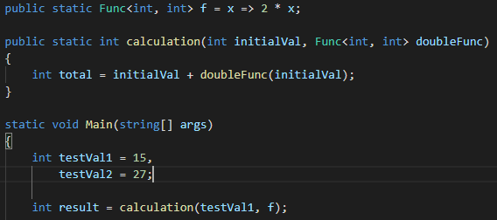
Higher Order Functions
Functions as arguments or return values of other functions
Toby
16/22

Slide 17
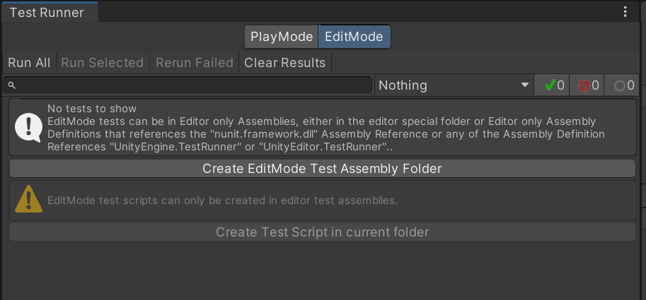
Edit Mode Vs. Play Mode tests
Edit mode:
Tests code that doesn’t require a running scene to test
More useful for calculation
Much faster to run
Play mode:
Tests code that needs to be executed in a running scene
Tests are ran as coroutines
More useful for testing things like movement
Chadwick
17/45

Slide 18
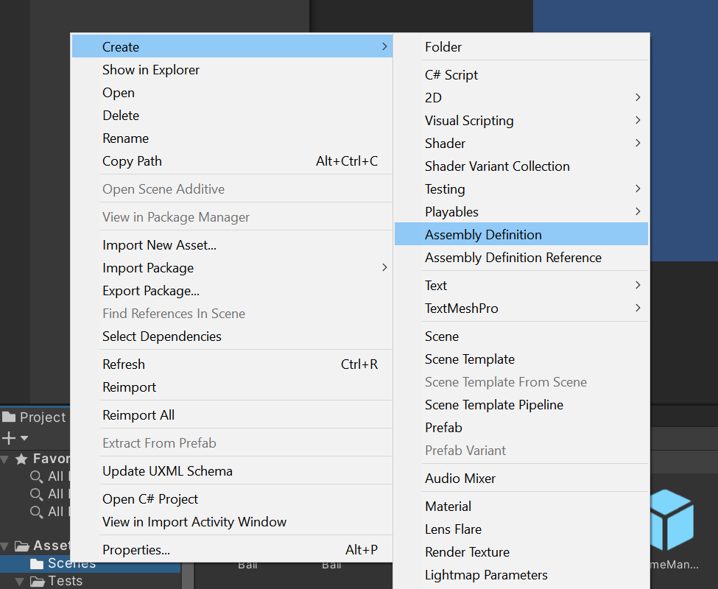
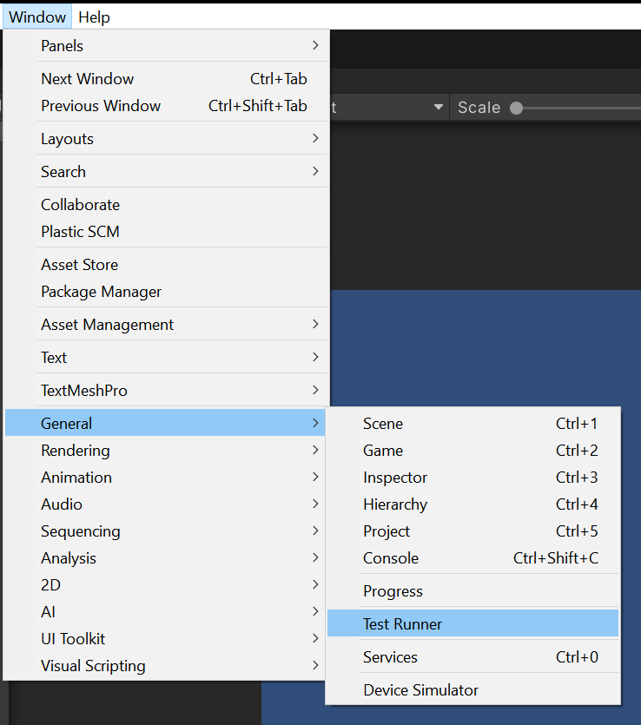
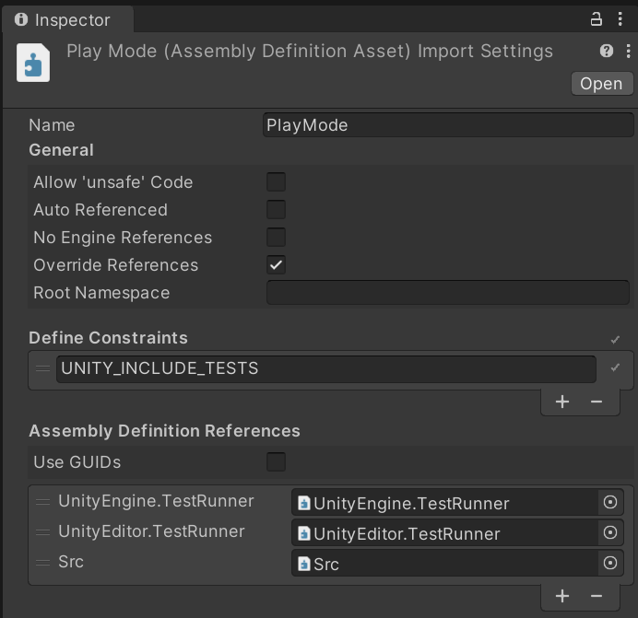
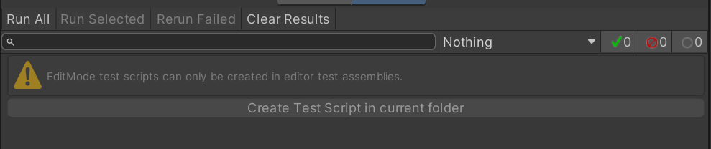
Setting up Testing (Refer to the how to document)
Chadwick
18/45

Slide 19
Boundary Tests
What are boundary tests?
A boundary test is any sort of test that checks whether a value is within some specified range
These tests can check for if a value is within, on, or outside of a boundary
Chadwick
19/45

Slide 20
Creating Unit Boundary Tests
3 main areas of a unit test
Arrange
Act
Assert
A boundary test is a specific type of unit test
Tests to verify that edge cases are properly handled
Verify that unexpected behaviour doesn’t occur if given unexpected values
Tests just inside the boundary
Tests on the boundary
Tests just outside the boundary
Toby
20/45

Slide 21
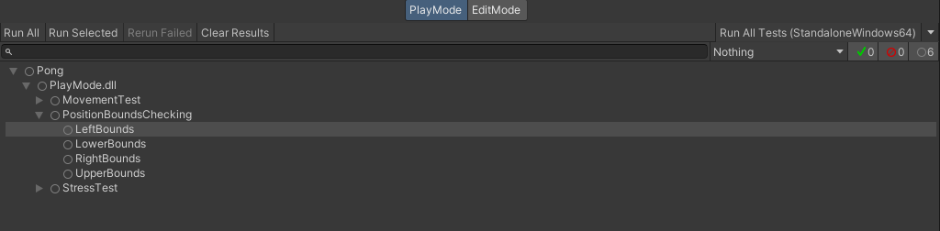
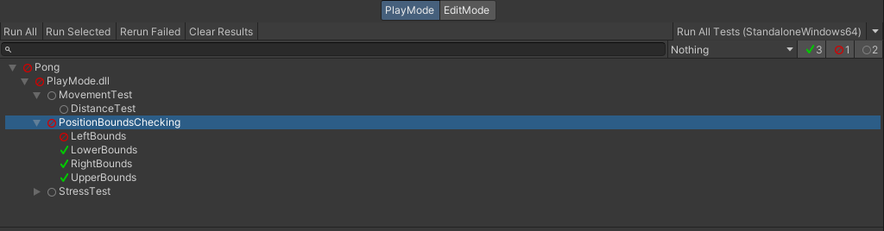
Executing tests
Toby
21/45

Slide 22

Stress Tests
What is a stress test?
A stress test is a test that applies stress to the system in an incremental manner until something breaks
The breaking point is recorded and is the measured limit of the software
Examples of failure under stress tests:
Failure to detect physical collision
Significant drop in frame rate
Doesn’t have to be automated
Will be different depending on the system
Chadwick
22/45

Slide 23
Patterns
Bob
23/45

Slide 24
What is a pattern
•Used to carry out the same functionality as other code
•Intended to make code easier to understand and maintain, as well as reduce coupling
•Since they see such widespread use, chances are any issues will be discovered before you start using them
Bob
24/45

Slide 25
Creational Patterns
Bob
25/45

Slide 26
Factory
•The factory is one of the simpler patterns. The goal here is to reduce coupling when instantiating new objects.
•Example: Eggs
Bob
26/45

Slide 27
Abstract Factory
•Factory that creates factories
•Useful when we have whatever set of things we want to create in a factory but want some of them need to be in their own distinct groups.
•Example: Tile Hero Enemy Groups
Bob
27/45

Slide 28
Builder
•Simplifies a process where there are multiple steps each having different possible pieces
•Example: Tile Hero Random Tile
Bob
28/45

Slide 29
Resource Pool
•Instantiate a reasonable amount of resource intense objects towards the start, then loan them to different objects/processes as needed.
•Reduces work on the system so that it doesn’t have to re create the resource intense objects repeatedly.
•If the loaned amount gets low, it should seek for the opportune time to instantiate new objects, though implementation of this is not required.
Bob
29/45

Slide 30
Prototype
•Create one version of the object only to be copied, not used
•Unity’s prefab feature handles this for us
•To use this as your pattern you would need to create your own code and just use prefabs
Bob
30/45

Slide 31
Structural Patterns
Bob
31/45

Slide 32
Adapter
•Take a class that’s incompatible with another class or function and encase it in an adapter to make it work as if it were.
•Example: Coordinates
Bob
32/45

Slide 33
Composite
•Composites apply to tree like structures made up of primitive elements and composite elements
•In the addition tree, addition operators are Composites, they’re made up of two components and are handled differently than the single integers, which are primitives
•Example: Menus
Bob
33/45

Slide 34
Facade
•The façade takes a complicated system and provides a simple interface for the user
•Example: Shop
Bob
34/45

Slide 35
Proxy
•Hide the real object behind a proxy object that either communicates with the real object or will allow the real object out once a condition is met.
•Example: Bats
•Example: Statues
Bob
35/45

Slide 36
Behavioral Patterns
Bob
36/45

Slide 37
Command
•Separate the command from the issuer and the receiver
•Allows us to manipulate the command freely as an object
•Example: High Budget Dungeon Jump
Bob
37/45

Slide 38
Iterator
•Allows a client to access what they need from a data structure without understanding the data structure.
•Example: Person with a messy house
Bob
38/45

Slide 39
Mediator
•Decouples interactions between two entities and allows easier many to many communication
•Example: Combat Manager
Bob
39/45

Slide 40
Observer
•Facilitates decoupled one to many communication
Bob
39/45

Slide 41
Memento
•A memento is an object which stores the state of an object when it is created and will return the object to that state when returned.
•The memento cannot do anything else, so it must have another object with it in order for it to return to the originator.
•Example: Save System
•Example: Restore State Item
Bob
40/45

Slide 42
State
•Used to facilitate a state machine style object which switches between distinct classes
•Must have a separate object which notifies the current state to change, and the current state must encapsulate different classes depending on its state
•Example: Lightswitch
Bob
41/45

Slide 43
Template Method
•Create a general framework for several different classes with minor variances
•Differences in behavior between different subclasses can be accounted for by overriding certain functions
•Example: Firefighter and Post Worker
Bob
42/45

Slide 44
Strategy
General Approach applicable to an interface which can be adjusted to fit a specific implementation
Ex: Transportation
Ex: Screen saver
Bob
43/45

Slide 45
Null Object
•This is an object which does nothing
•Intended to be used when some object is required but no action is wanted
•Example: Strategy/Template
Bob
44/45

Slide 46
Other Patterns
NOTE: Some websites group these together others include them in their respective category
•Private Data Class
•Flyweight
•Bridge
•Chain of Responsibility
•Interpreter
•Visitor
Bob
45/45

Slide 47
Private Data Class
• Issue: We want to have class data that is changed on construction but is otherwise immutable
• Solution: Create a new data class within our main class which stores all data in private variables and call methods within this class to retrieve values
Bob
44/45

Slide 48
FlyWeight
• Issue: We want really fine control of an object but it is expensive to create many
• Solution: Have a separate “smart” handler which carries out fine action and updates many “stupid” objects
Bob
44/45

Slide 49
Bridge
• Issue: We want to be able to freely change our abstraction and implementation without affecting each other
• Solution: Create an interface, then an implementation for that interface, then an interface for that implementation, then have concrete implementations for that interface
Bob
44/45

Slide 50
Chain of Responsibility
• Issue: Many “handlers” may need to handle the request of a client, client does not need to know system inner workings
• Solution: Client sends request to a main handler who knows the chain of responsibility. Main handler sends request to each handler and if they can handle it they return the solved request otherwise they return that they cannot solve the request
Bob
44/45

Slide 51
Interpreter
• Issue: We have a series of “problems” that could be handled as if they were a language
• Solution: Create an object which can keep track of necessary context to process sentences
Bob
44/45

Slide 52
Interpreter
• Issue: We have a series of “problems” that could be handled as if they were a language
• Solution: Create an object which can keep track of necessary context to process sentences
Bob
44/45

Slide 53
Visitor
• Issue: We want to perform operations on between similar objects without needing to manually change all of them
• Solution: Put the operation on a separate object and have this object visit the objects to update them
Bob
44/45

